Slide 1

Traditional Methodologies VS Agile Methodologies By Vidya Janani V

Slide 2
Objectives of Traditional Model
The objective of traditional methodologies is
To deliver a well-defined, predictable, and high-quality product.
By following a structured, sequential process where each phase is completed fully before moving to the next
By Ensuring clear documentation, minimized risks, and easier project management.

Slide 3
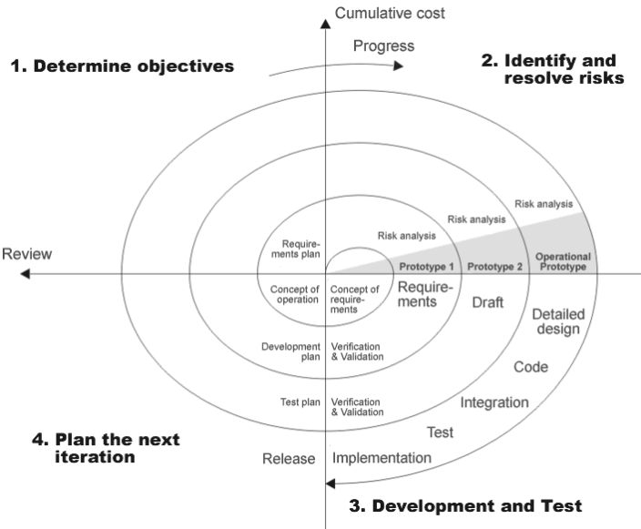
Process of Traditional Methodology - Spiral Model
The Spiral Model is an iterative development process focusing on risk analysis, prototyping, and
Continuous customer feedback through repeated cycles, refining the product at each stage.

Slide 4
Major Drawbacks of Traditional Methodologies
Rigid to Changes
Late Testing
High Risk
Long Delivery Time
Less Customer Involvement

Slide 5
What are the need of New Methodologies
Traditional methods are rigid, slow, and less customer-focused.
Modern projects demand flexibility, faster delivery,
and continuous feedback.
Need for handling evolving requirements and reducing risks early.

Slide 6
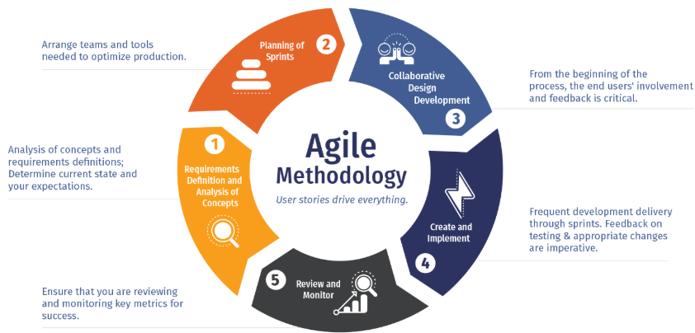
What IS AGILE ?
Agile = Flexibility + Speed + Customer Collaboration
Breaks project into small, manageable units
(iterations/sprints)
Continuous development,
testing, and feedback
Welcomes changing
requirements anytime

Slide 7
How Latest Methods Solve Traditional Problems
Traditional Problem | Agile Solution
Inflexibility | Iterative and adaptive approach
Late error detection | Continuous testing in every sprint
Slow delivery | Frequent small releases
Poor customer collaboration | Regular feedback after every sprint

Slide 8
ADVANTAGES OF AGILE MODEL
Flexibility to Changes: Agile easily adapts to evolving requirements
at any stage of development.
Faster Delivery: Working software is delivered in small, frequent
iterations, ensuring quicker results.
Continuous Customer Feedback: Regular reviews ensure the product is
aligned with customer needs.
Early Problem Detection: Continuous testing helps identify and
fix issues early in the process.
Better Team Collaboration: Frequent meetings and open communication
enhance teamwork and clarity.
Higher Customer Satisfaction: Ongoing updates and customer
involvement ensure the final product meets expectations.

Slide 9
Advantages of Agile over Traditional Methodologies
Aspect | Agile | Traditional Methodologies
Flexibility | Highly flexible, adapts to changes easily. | Rigid; changes are difficult and costly.
Delivery Speed | Delivers in smaller, frequent iterations. | Slow, delivers the final product at the end.
Customer Involvement | Continuous feedback and collaboration with customers. | Limited involvement after the initial requirements phase.
Risk Management | Risks are identified and addressed continuously. | Risks are addressed mostly during the planning phase.
Error Detection | Early and frequent testing leads to early problem detection. | Testing happens only at the end, issues are detected late.
Team Collaboration | Frequent communication and teamwork through daily stand-ups. | Limited communication across teams; phases are completed independently.

Slide 10


